Slide 1
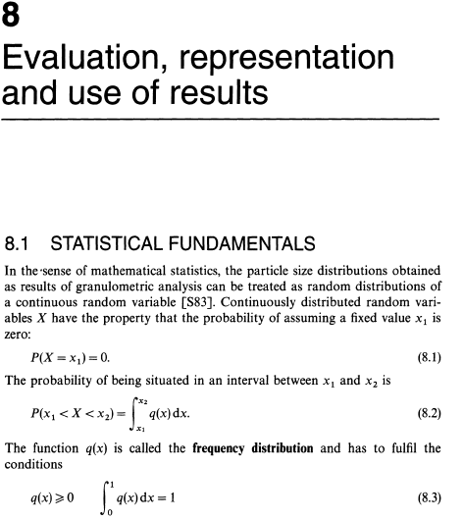
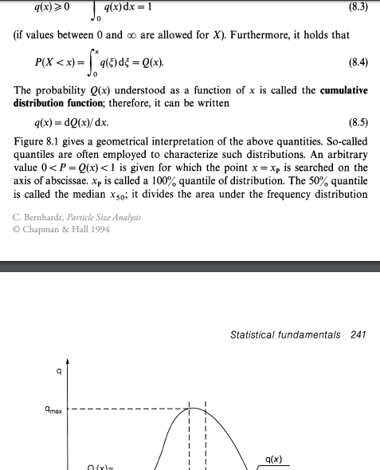
https://link.springer.com/chapter/10.1007%2F978-94-011-1238-3_8

Slide 2
